Slide 1
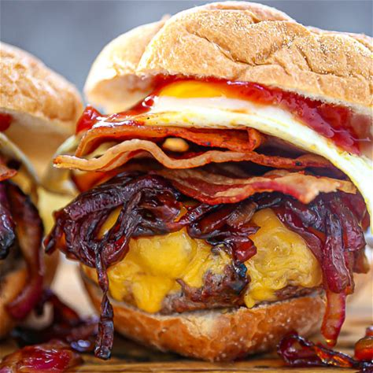
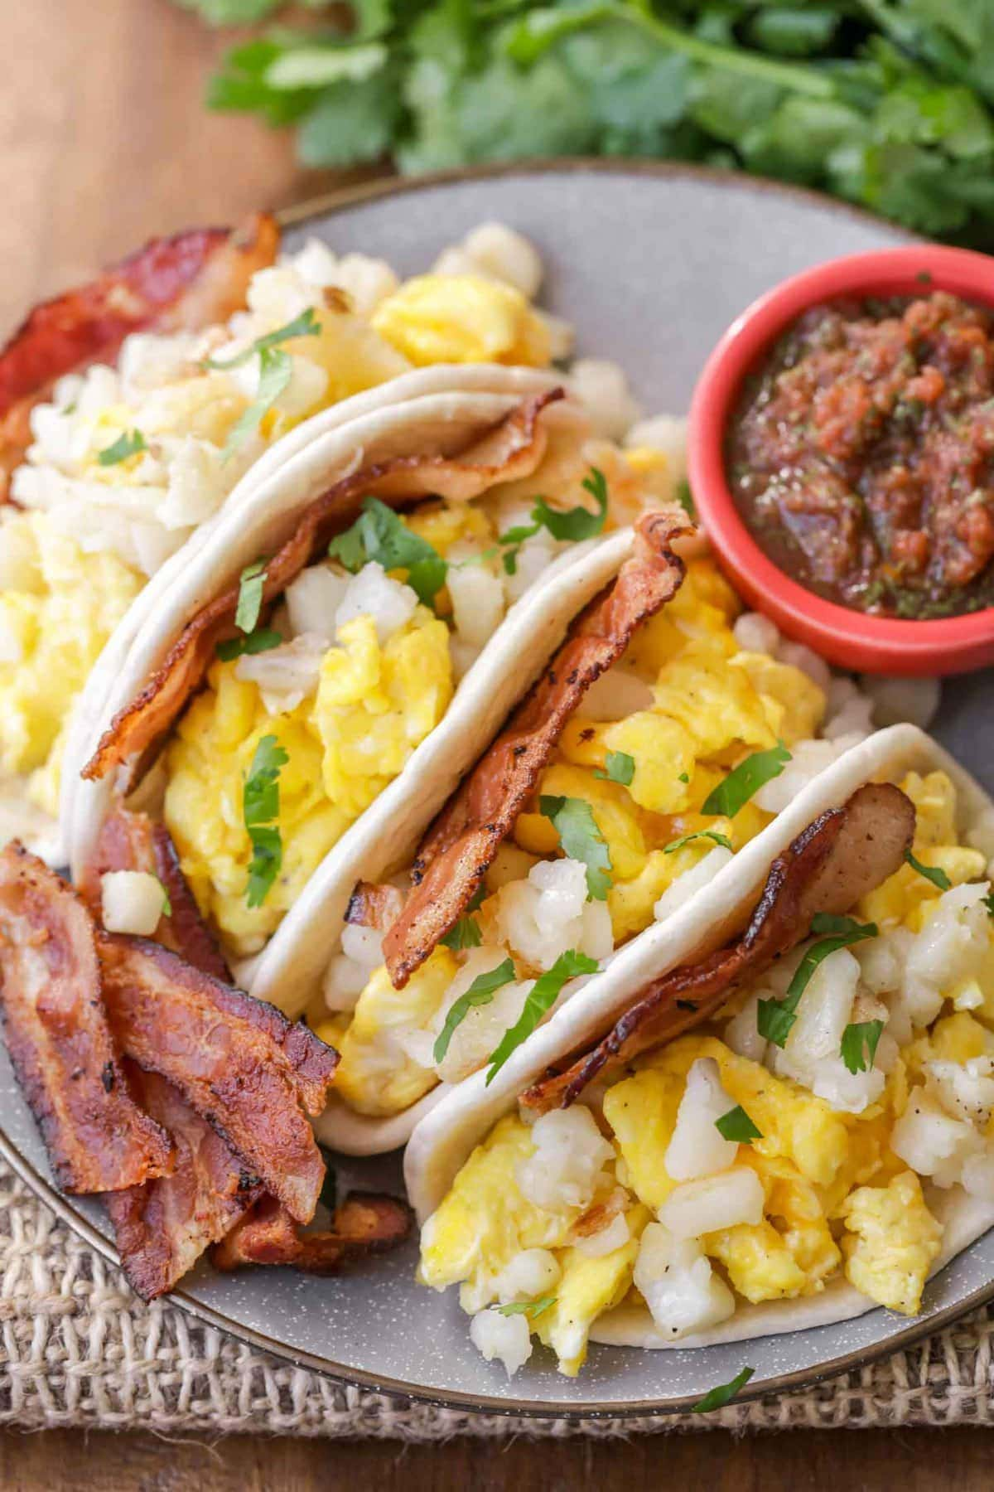
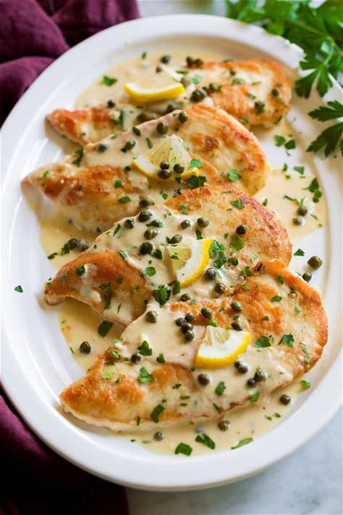
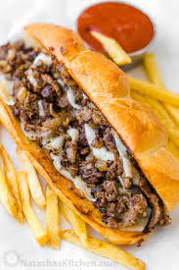
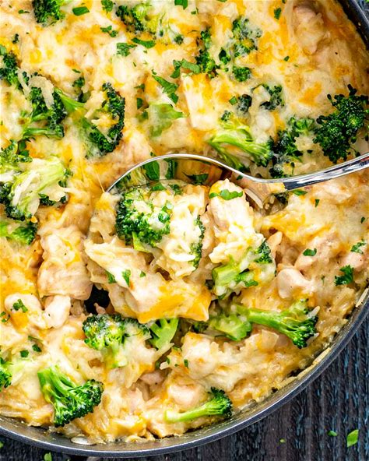
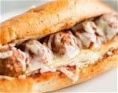
Weekly special:aug7 –aug13
Call ahead 703-491-1884
Monday
Special: fried egg burger
All American $5
Turkey burger $5
Bacon cheeseburger $6
Patty melt $6
Tuesday
Special: breakfast tacos
Beef or chicken
House tacos $2.50
House nachos $7
House taco salad $8
Wednesday
Special: SPICY OLD BAY
8 Bone-in $10/ 8 boneless $6
Sauces: mild buffalo, hot house buffalo, Nashville hot, Kentucky bourbon, backyard bbq, sweet thai chili, garlic parmesan, honey mustard, bry rub or naked
Thursday
cheddar Broccoli chicken casserole $13
FRIDAY
lemon pepper chicken piccatta with rice and veggies $15
SATURDAY
SPECIAL: CHEESE STEAK/ CHICKEN $8
SUNDAY
Sunday brunch ala carte
Special of the week
Meatball sub w/ ff $12
Bullet points
Monday night burger night
Terrific taco Tuesday
Country cooking thursday
Free music Friday
Steak and cheese Saturday
Sunday brunch

