Slide 1



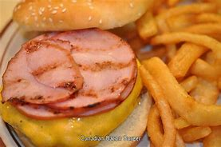

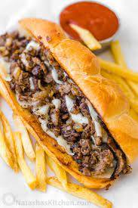
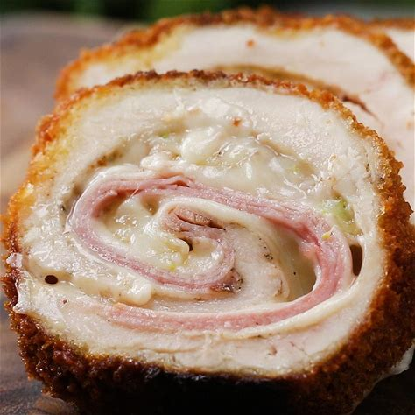
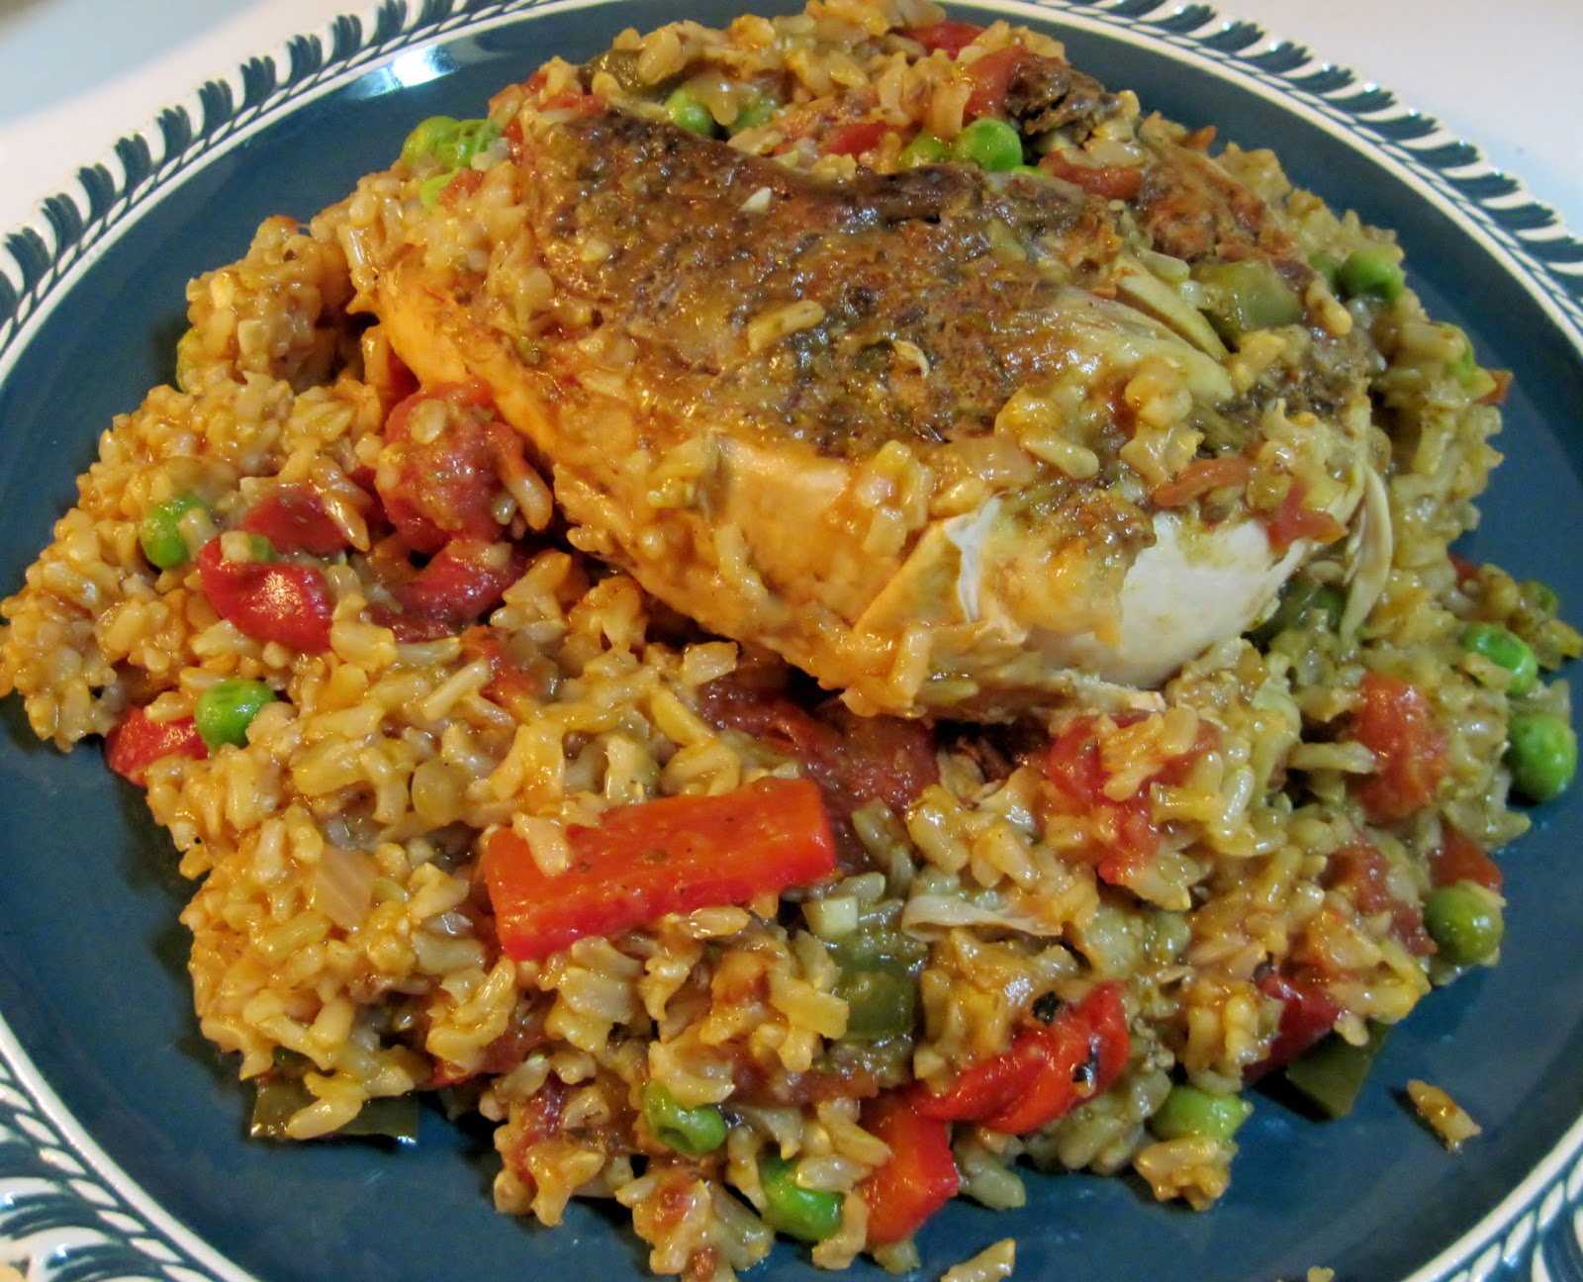
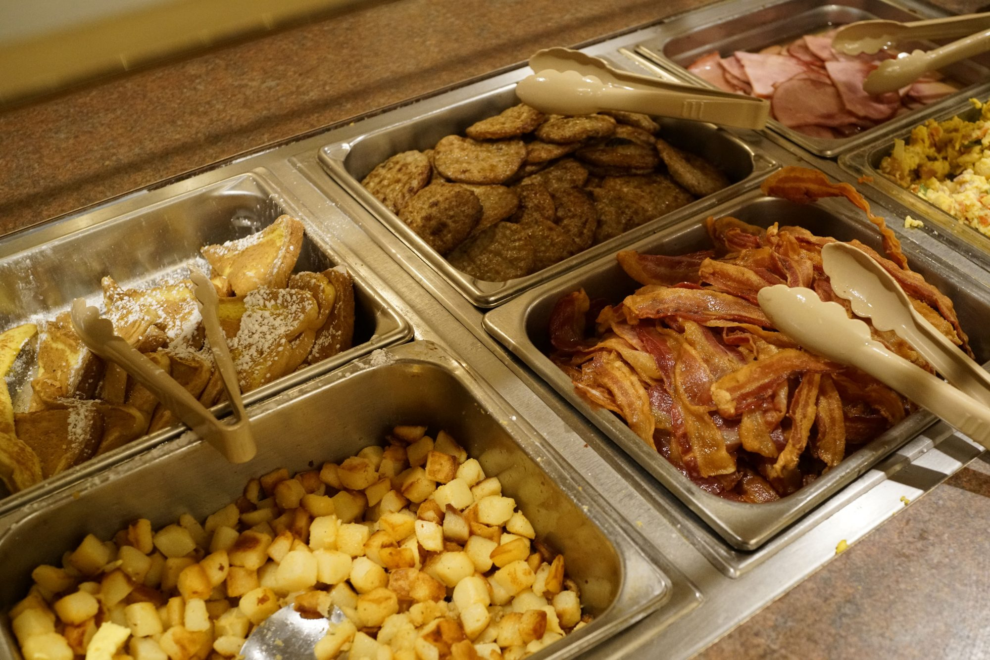
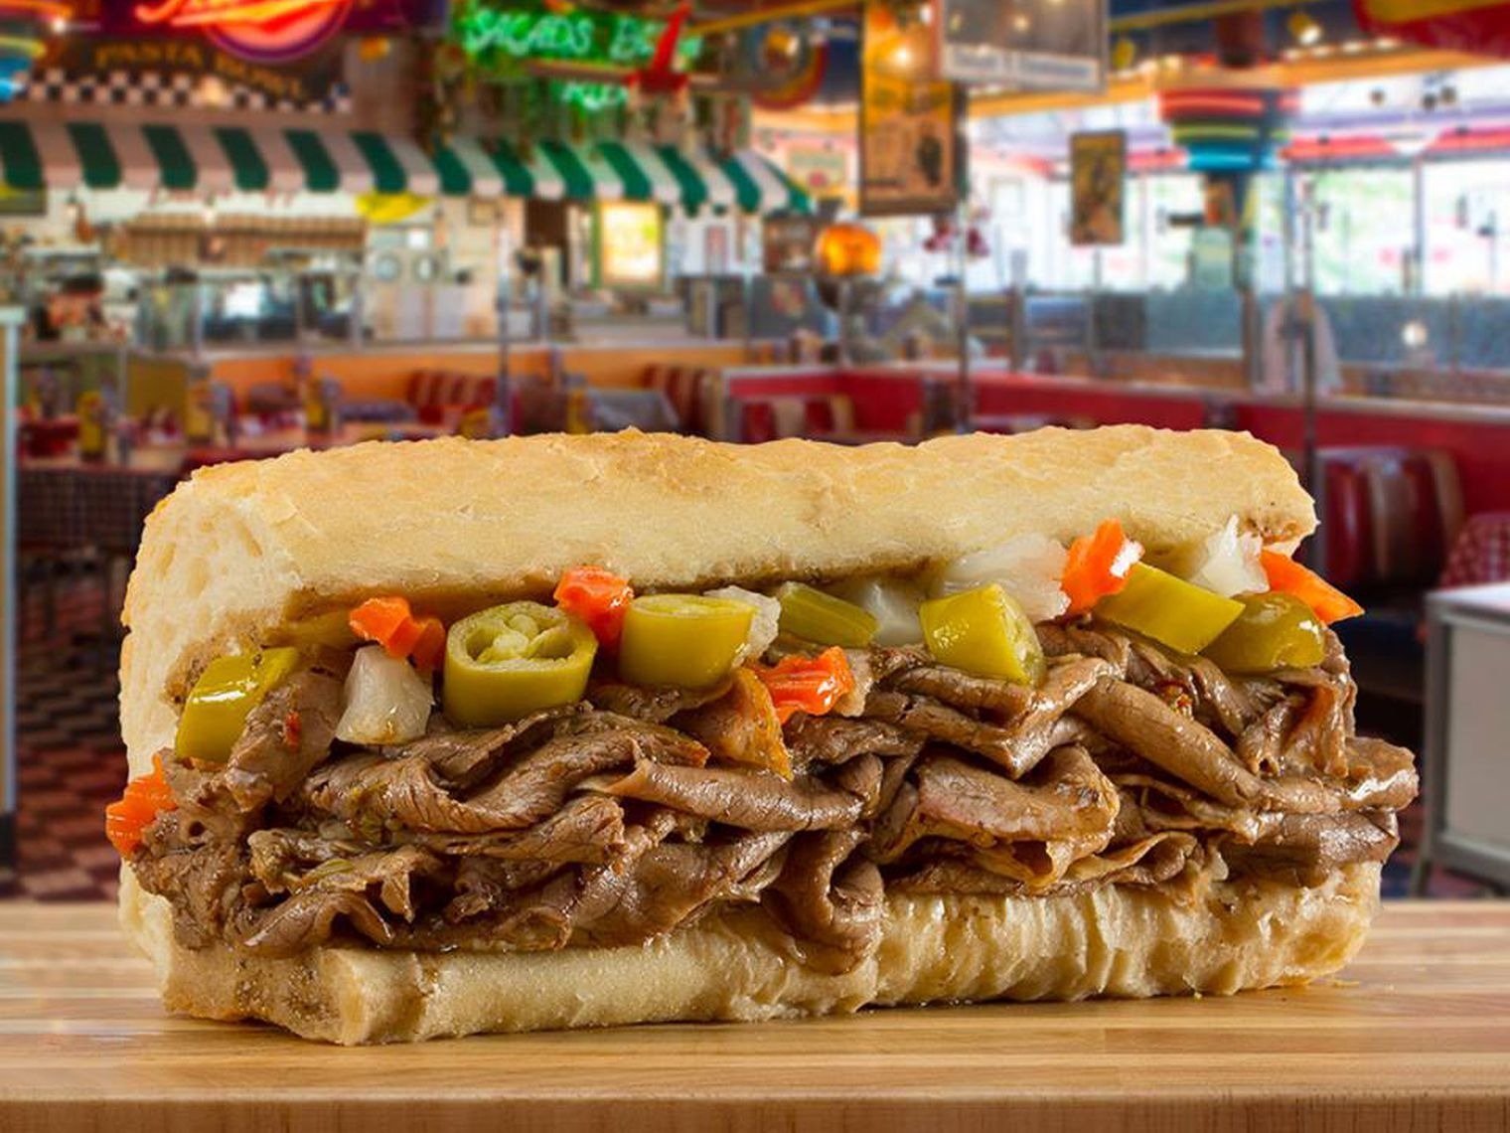
Weekly special: APR2 –apr 9
Call ahead 703-491-1884
Monday
Special: CANADIAN BACON BURGER
All American $5
Turkey burger $5
Bacon cheeseburger $6
Patty melt $6
Tuesday
Special: EGG HAM AND CHEESE TACOS
Beef or chicken
House tacos $2.50
House nachos $7
House taco salad $8
Wednesday
Special: habenaro mango
8 Bone-in $10/ 8 boneless $6
Sauces: mild buffalo, hot house buffalo, Nashville hot, Kentucky bourbon, backyard bbq, sweet thai chili, garlic parmesan, honey mustard, bry rub or naked
Thursday
THE CELSO SPECIAL
ARROZ CON POLLO AND TOSTONES $13
FRIDAY
CHICKEN CORDON BLEU SERVED OVER CHEESY RICE AND BROCCOLI AMD GREN BEANS $14
SATURDAY
SPECIAL: CHEESE STEAK/ CHICKEN $8
SUNDAY
Sunday brunch buffet $12
EASTER SUNDAY POT LUCK
Special of the week
CHICAGO HOT BEEF SANDWHICH W/FF
$12
Bullet points
Monday night burger night
Terrific taco Tuesday
Country cooking thursday
Free music Friday
Steak and cheese Saturday
Sunday brunch easter pot luck

